Slide 1
Logo UTeM
Tittle Font
Arial Narrow Bold
Size : 48-60
Color : Blue
C:91 M:74 Y:11 K:1
R:47 G:85 B:152
Lecturer Nama
Century Gothic
Size : 20
Color : Blue
C:91 M:74 Y:11 K:1
R:47 G:85 B:152
Lecturer email
Century Gothic
Size : 16
Color : Grey
C:63 M:55 Y:54 K:28
R:89 G:90 B:90
Slide size : wide screen (16.9)
Logo PSTP
Font : Arial Narrow & Century Gothic

Slide 2
PART
Arial Narrow Bold
Size : 48-60
Color : Grey
C:63 M:55 Y:54 K:28
R:89 G:90 B:90
Tittle
Arial Narrow Bold
Size : 48-60
Color : Blue
C:91 M:74 Y:11 K:1
R:47 G:85 B:152

Slide 3
Example : Quotes
“A good teacher can insipe hope,
Ignite the imagination, and instill
a love of learning”.
Century Gothic
Size : 28
Brad Henry
Century Gothic
Size : 18

Slide 4
Color theme
C:97 M:78 Y:24 K:9
R:31 G:74 B:127
C:75 M:42 Y:100 K:38
R:57 G:88 B:41
C:17 M:75 Y:100 K:6
R:196 G:92 B:40
C:87 M:54 Y:0 K:0
R:24 G:112 B: 185
C:80 M:30 Y:100 K:18
R:54 G:120 B:58
C:2 M:49 Y:92 K:0
R:242 G:148 B:49
C:88 M:47 Y:39 K:12
R:27 G:107 B:127
C:62 M: 11 Y:98 K:0
R:112 G:173 B:69
C:10 M:30 Y:90 K:0
R:231 G:178 B:57
C:78 M: 26 Y:24 K:0
R:42 G:149 B:176

Slide 5
Examples : Infographic
Why?
What?
How?

Slide 6



Sensory Acuity
Icon
Visual
Auditory
Kinesthetic

Slide 7

Active Testing
DO
What If?
25%
What?
22%
LEARNING STYLES
4 MAT
Abstract
Hypothesis
THINK
FEEL
Concrete
Experience
Why?
30%
How?
23%
WATCH
Reflective Observation

Slide 8
Role & Stance
COACH
PROMOTER
TEACHER
TRAINER
MOTIVATOR

Slide 9
Training
Teaching
&
Lecturing
Special Skills
&
Consulting
Special
Knowledge
STANCE
Coaching
&
Mentoring
Advertising
&
Counselling

Slide 10
SELECT ONE SHAPE
1
2
3
4

Slide 11
1
Tringle won’t appreciate indecisiveness
2
Circle tend to accommodate or compromise
3
Square will want specifics or perhaps details in writing
Squiggles may not even perceive there’s an issue, but they can be competitive in defense of an idea
4

Slide 12
Century Gothic
Size : 18
visual learners
Learn a new idea or concept
It has also been commonly referred to as graphic or spatial
Visual learning occurs when the learner retains information when ideas, words and concepts are represented with some type of image
Visual

Slide 13
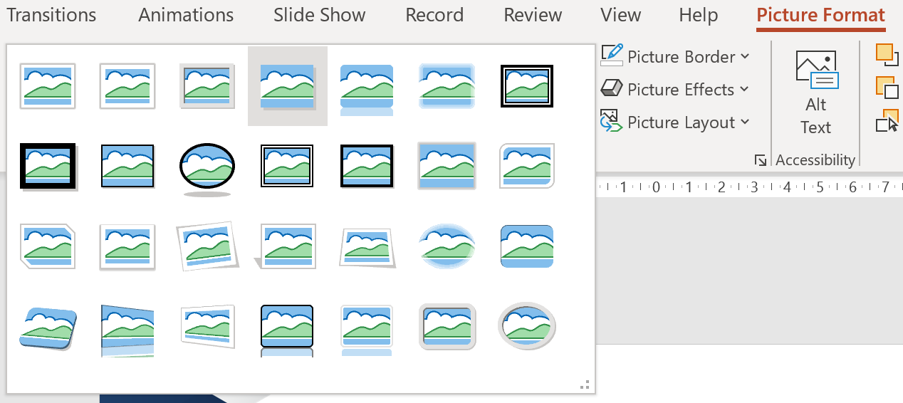

Image / Picture Format
Picture Format
Drop shadow rectangle

Slide 14
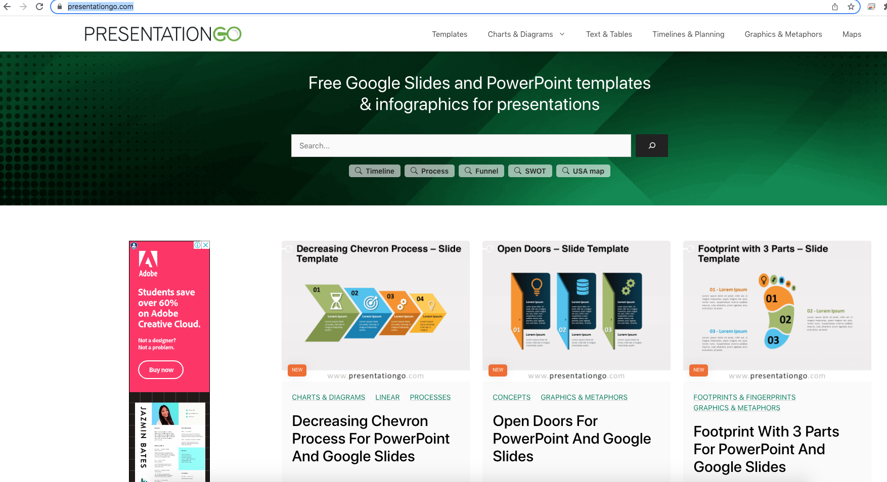
REFERENCES
https://www.presentationgo.com/

Slide 15
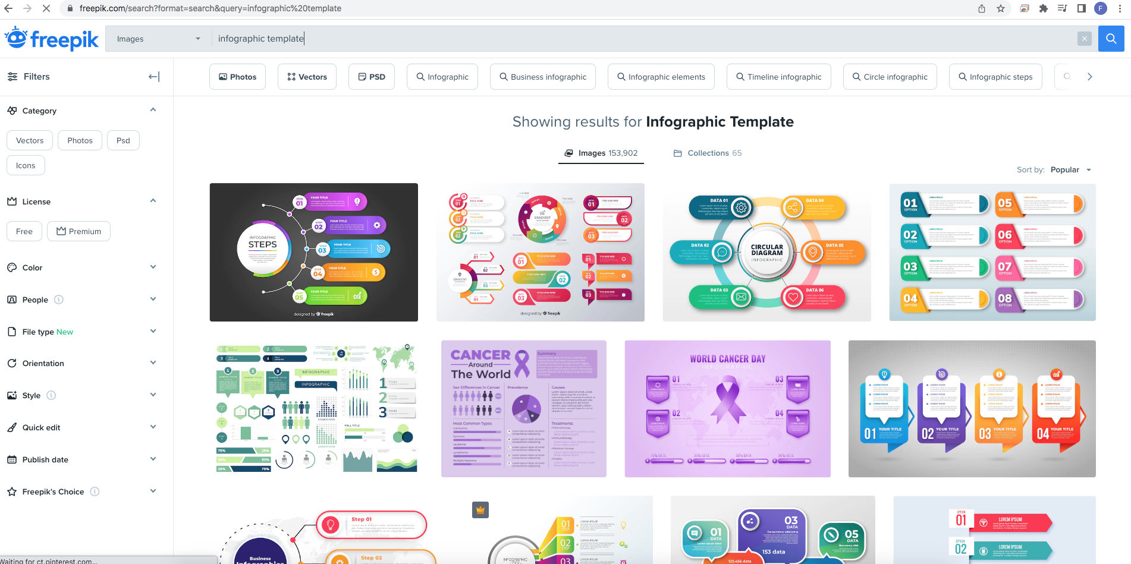
REFERENCES
https://www.freepik.com/

Slide 16
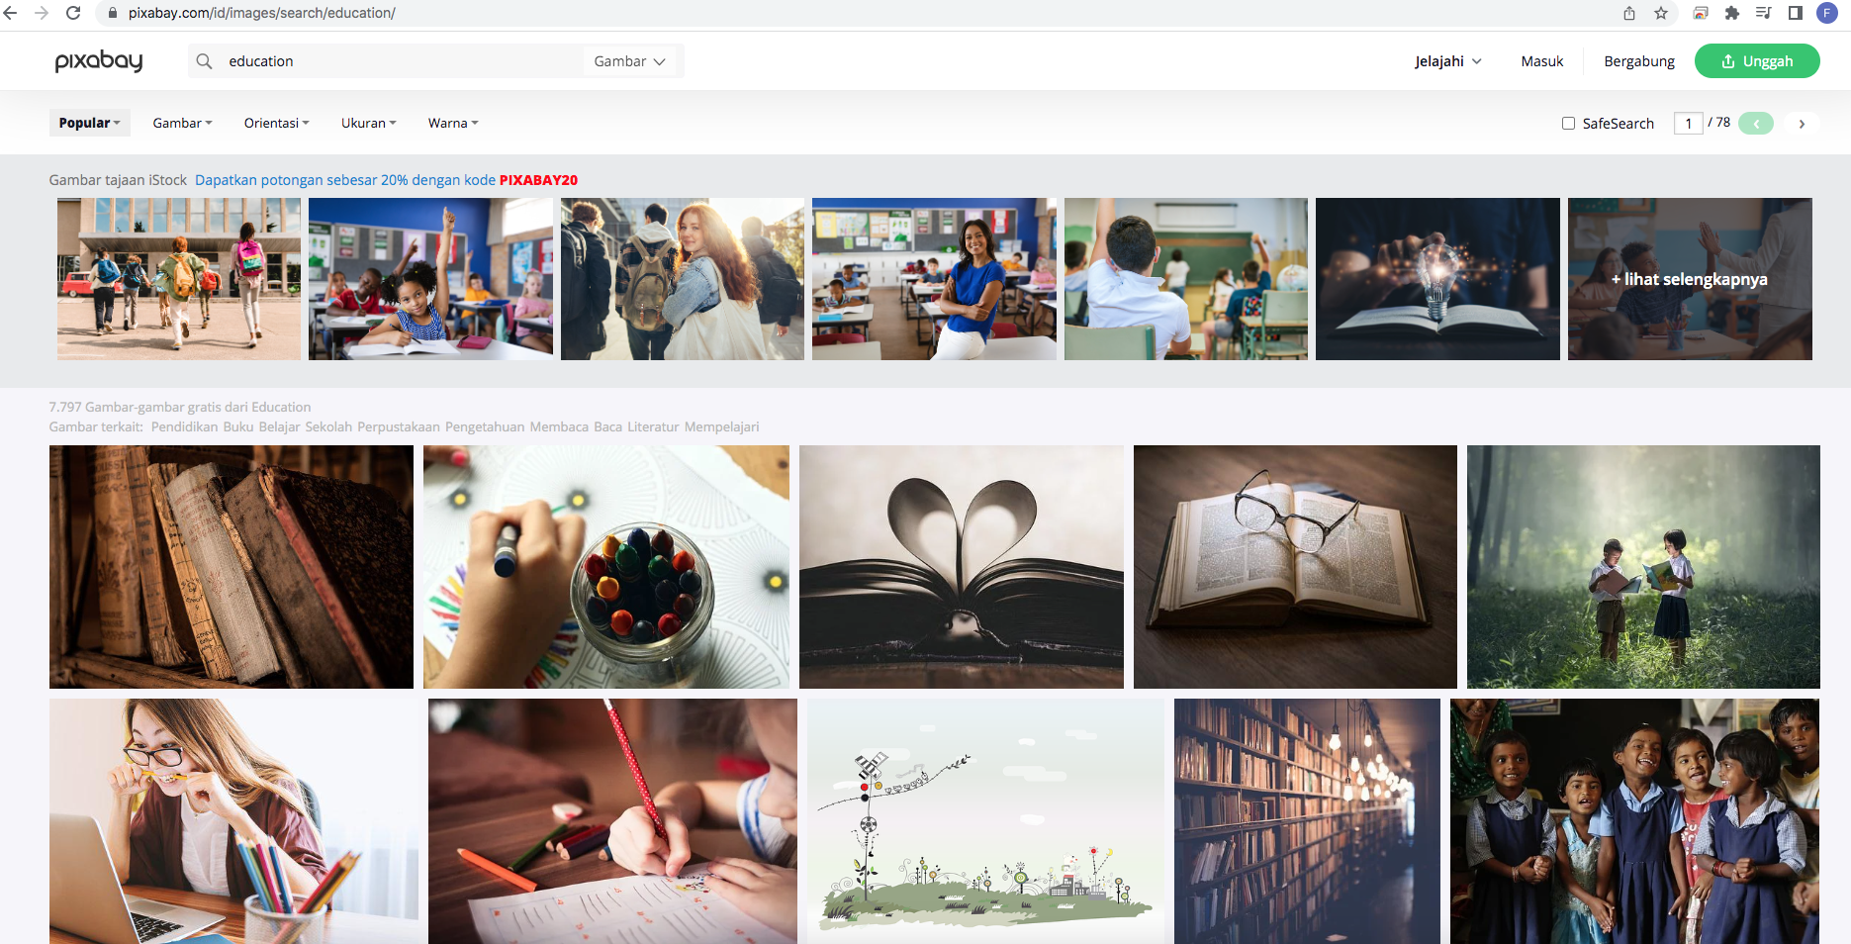
REFERENCES
https://pixabay.com/

Slide 17
Century Gothic
Size : 28

